Slide 1



DESIGN AND COMPLETE LAYOUT OF SAR-LOGIC CHIPLET

Slide 2
Content
Introduction
SAR RTL and Testbench
Constrains
Synthesis
STA and Data setup
Floor planning
Power planning
Placement
Clock tree synthesis
Routing
Prime Time

Slide 3

Introduction
Project Overview:
develop a 10-bit Successive Approximation Register (SAR) Analog-to-Digital Converter (ADC) with a 100 MS/s sampling rate. This device is intended for high-speed signal processing applications, requiring meticulous design optimization to meet timing, power, and area specifications.
Tool Used: Synopsys and SAED90nm technology library for design and analysis

Slide 4
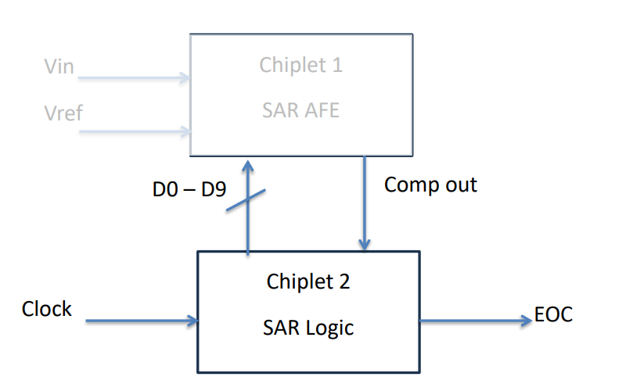
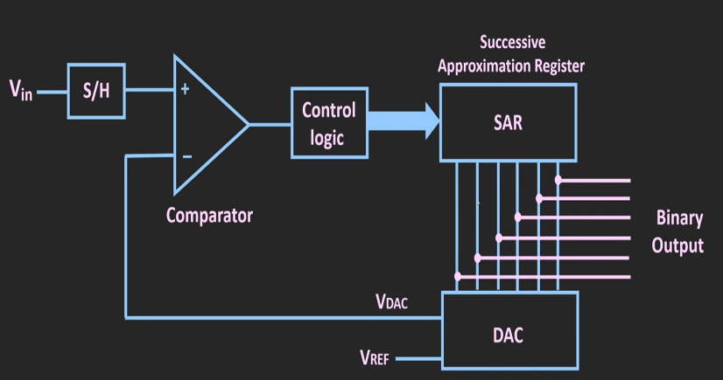

Slide 5
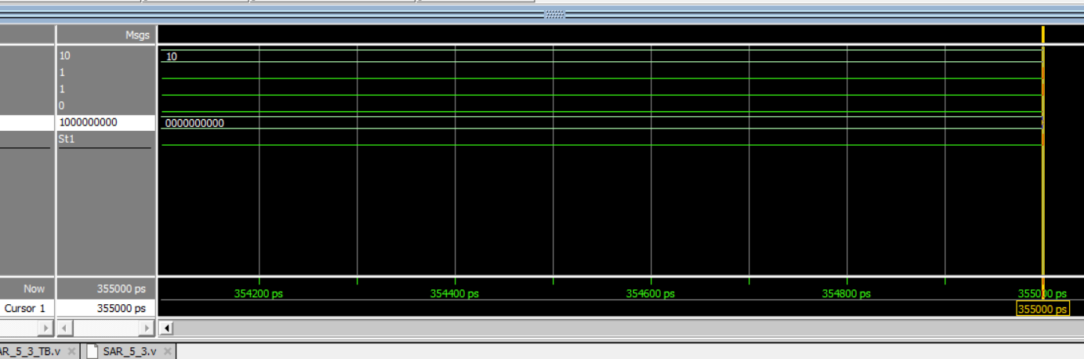
SAR ADC Logic RTL design and Testbench

Slide 6
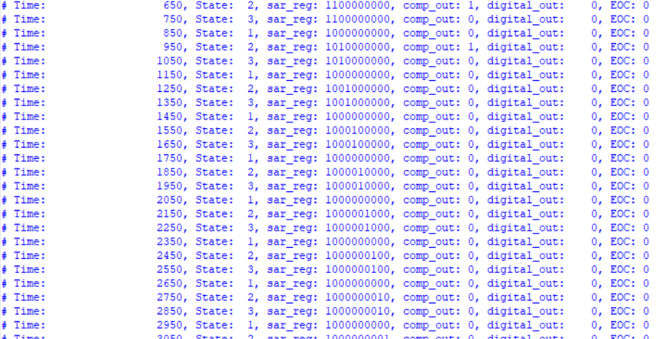

Slide 7
Constraints Setup
Clock Setup: A 1 ns clock period was specified, suggesting an operating frequency of 1 GHz. This is a critical parameter as it determines the timing constraints for the entire design.
Input and Output Delays: Delays of 0.3 ns are set for both inputs and outputs relative to the clock, which is crucial for ensuring data integrity and timing reliability.
Clock Uncertainty: Set at 50 ps to account for variations due to jitter and other factors, which is important for safe timing margins.
Clock Latency: A latency of 0.12 ns is specified, which covers the combined delays through the clock generation and distribution networks.

Slide 8
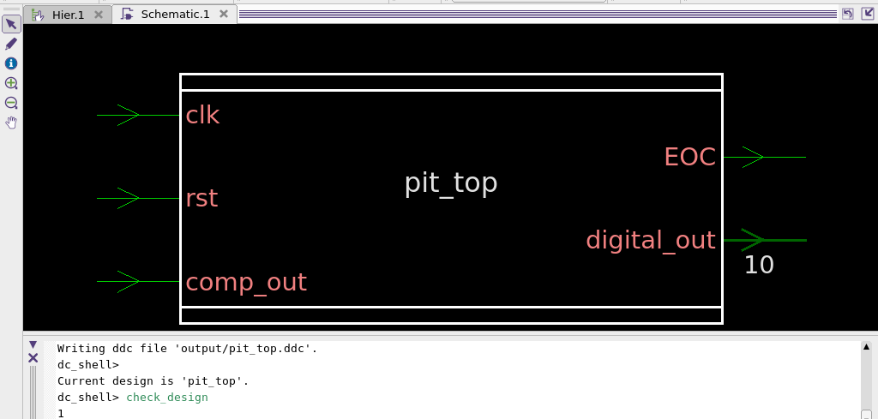

Slide 9
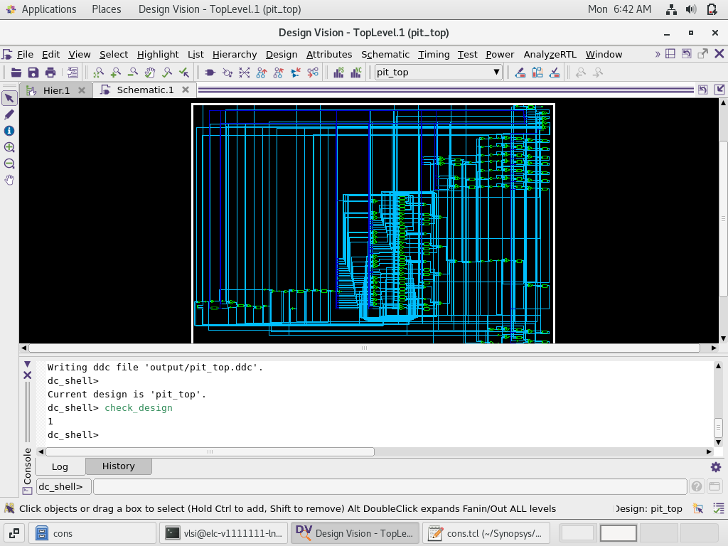
Schematic view of Synthesis netlist

Slide 10
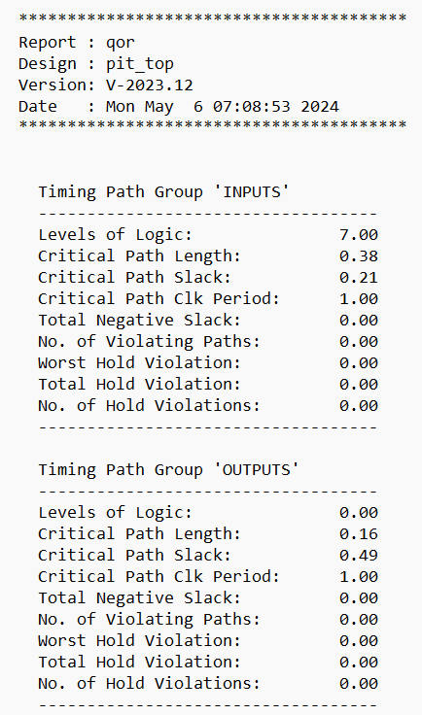
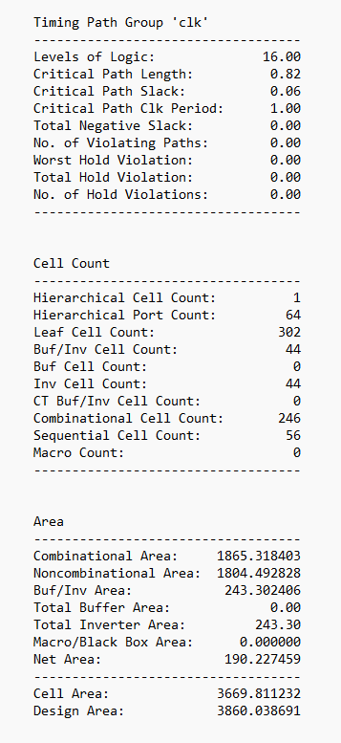
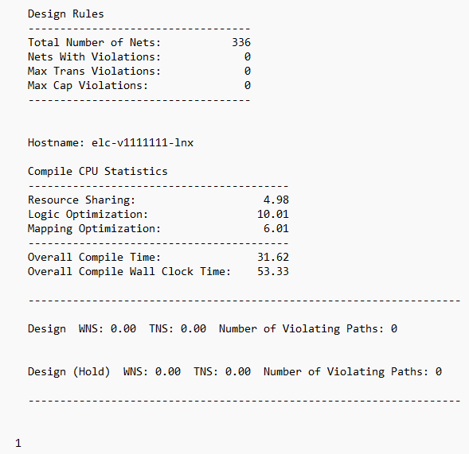
Synthesis Quality of results (qor)

Slide 11
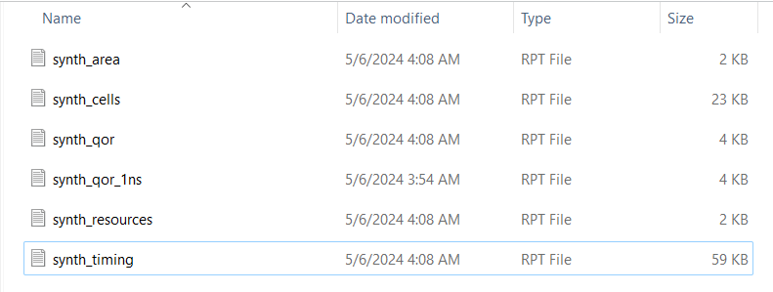
Synthesis Reports

Slide 12
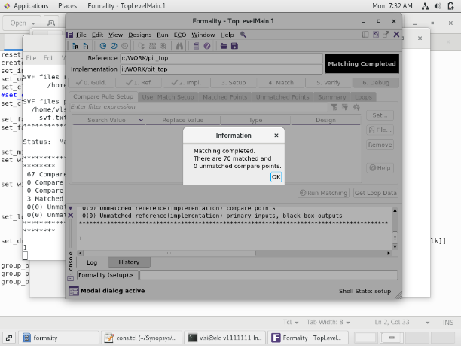
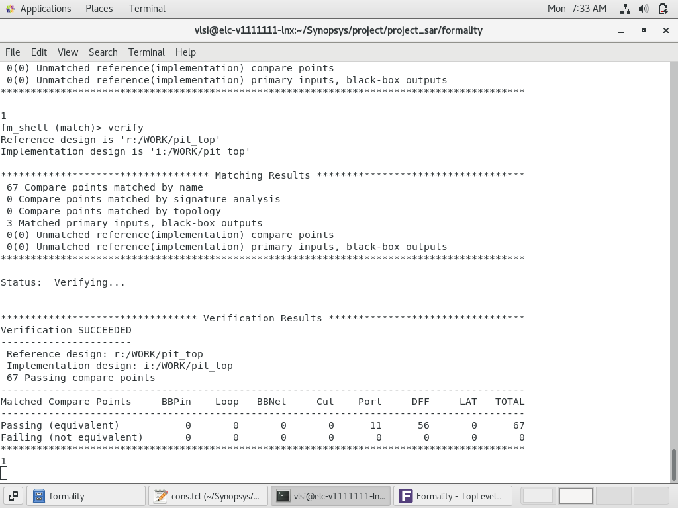
Formal Verification

Slide 13
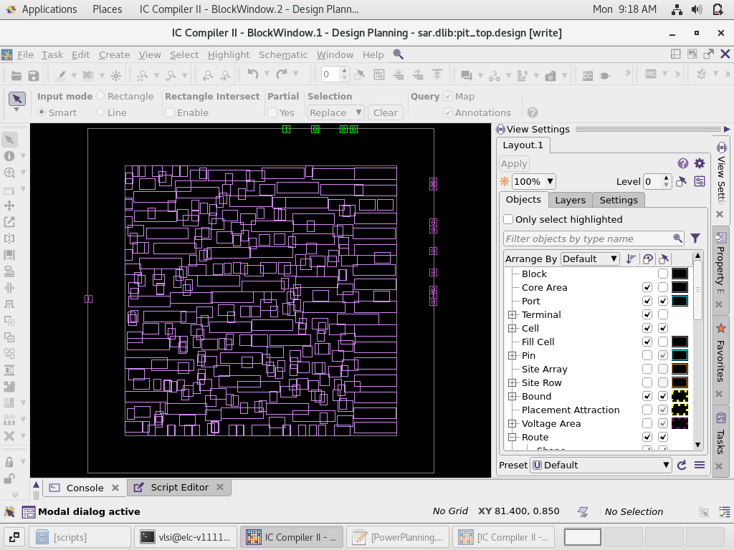
Floor Planning Layout

Slide 14
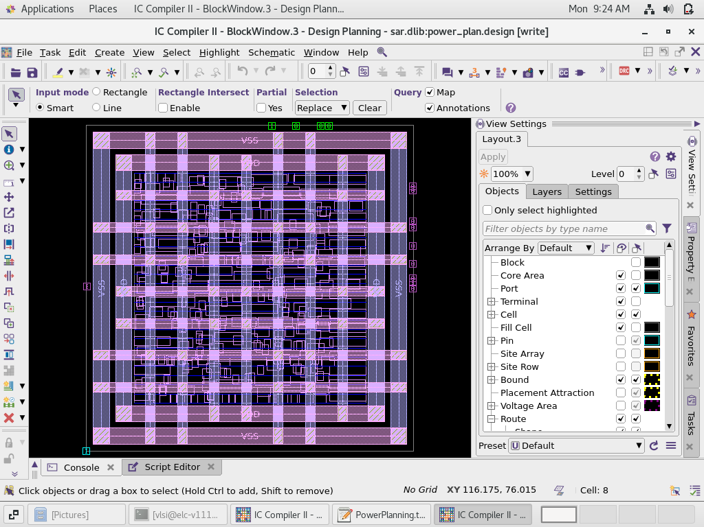
Power Planning Layout

Slide 15
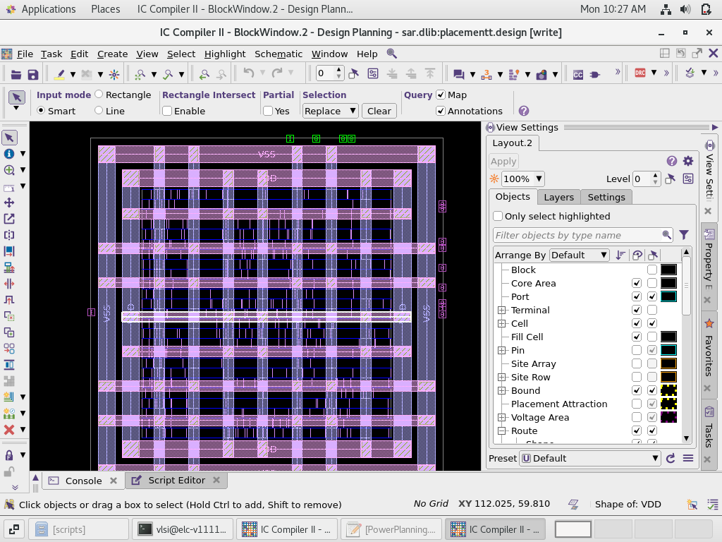
Layout view of placement

Slide 16
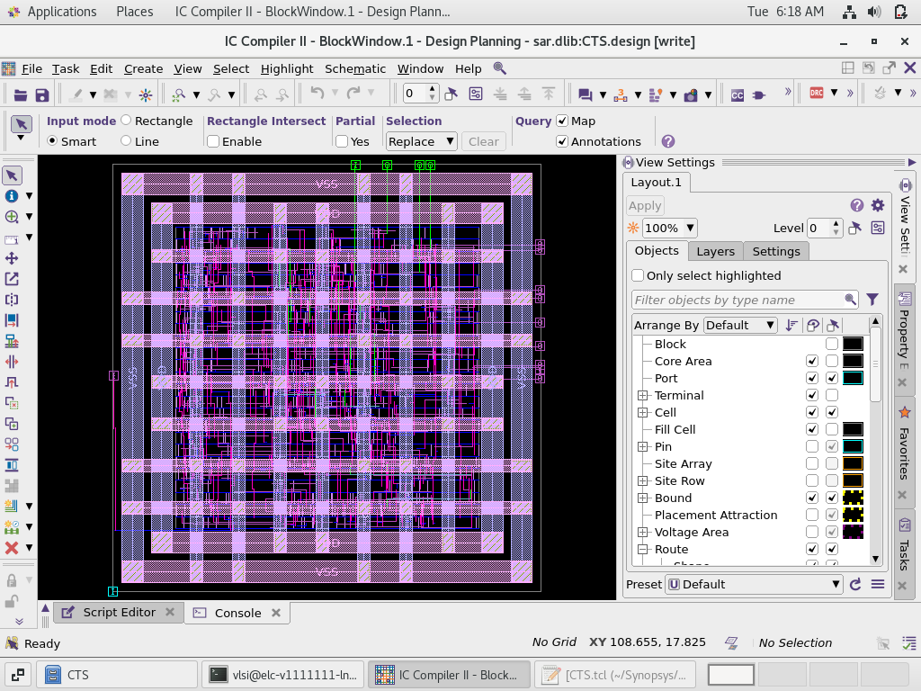
Clock tree synthesis (CTS) LAYOUT VIEW

Slide 17
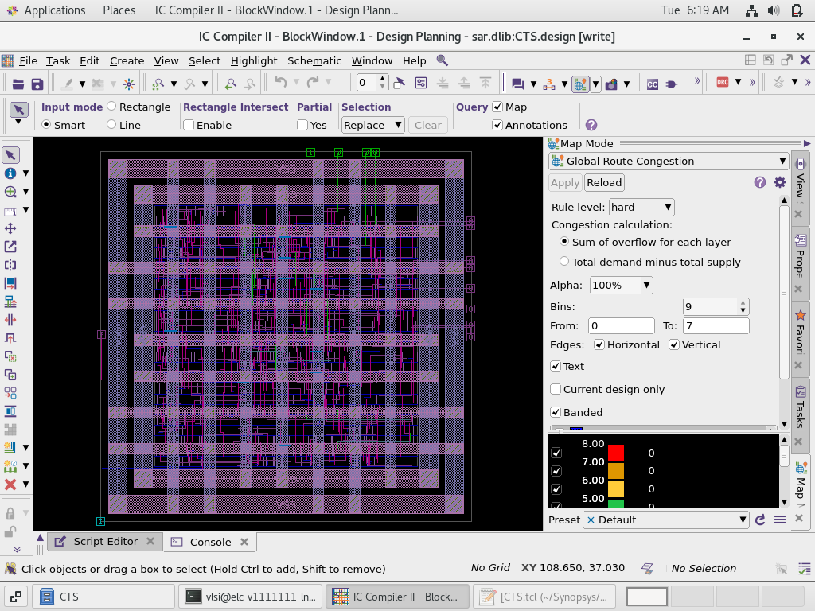
Global Route Congestion map

Slide 18
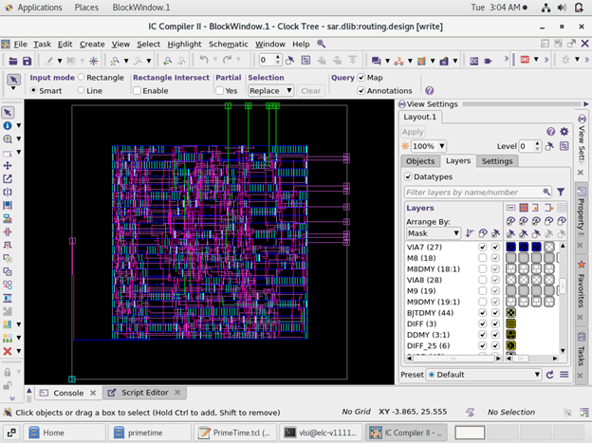
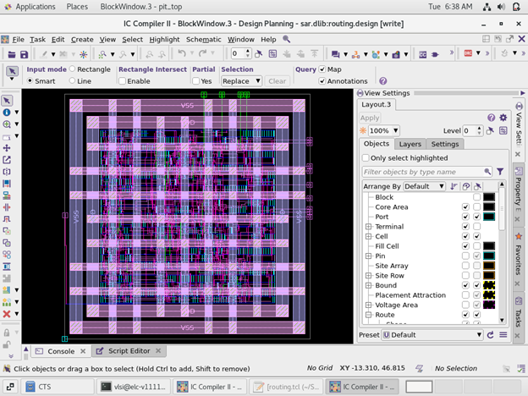
Routing layout view

Slide 19
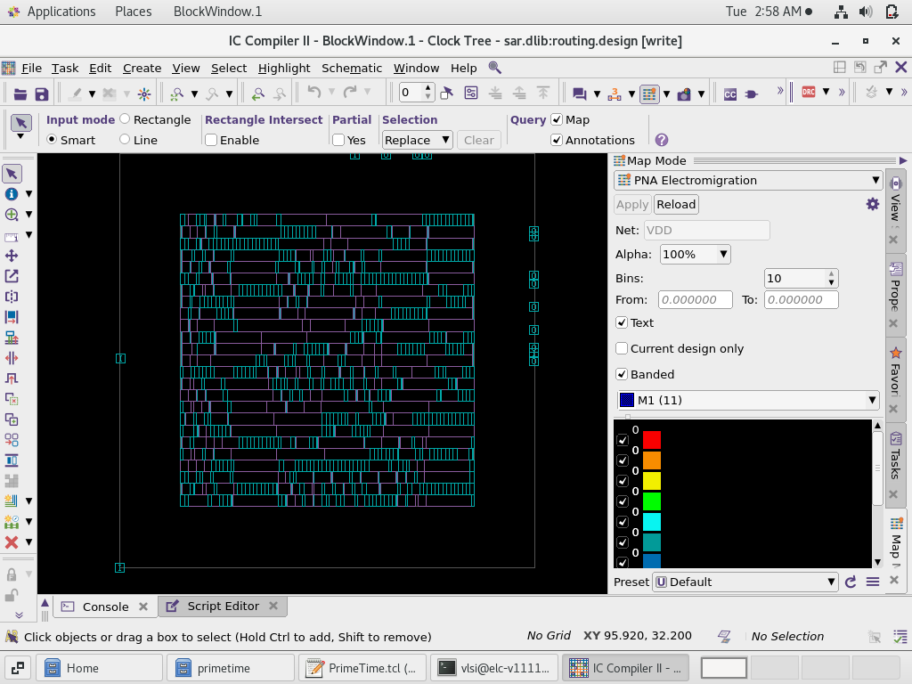
Filler cells

Slide 20
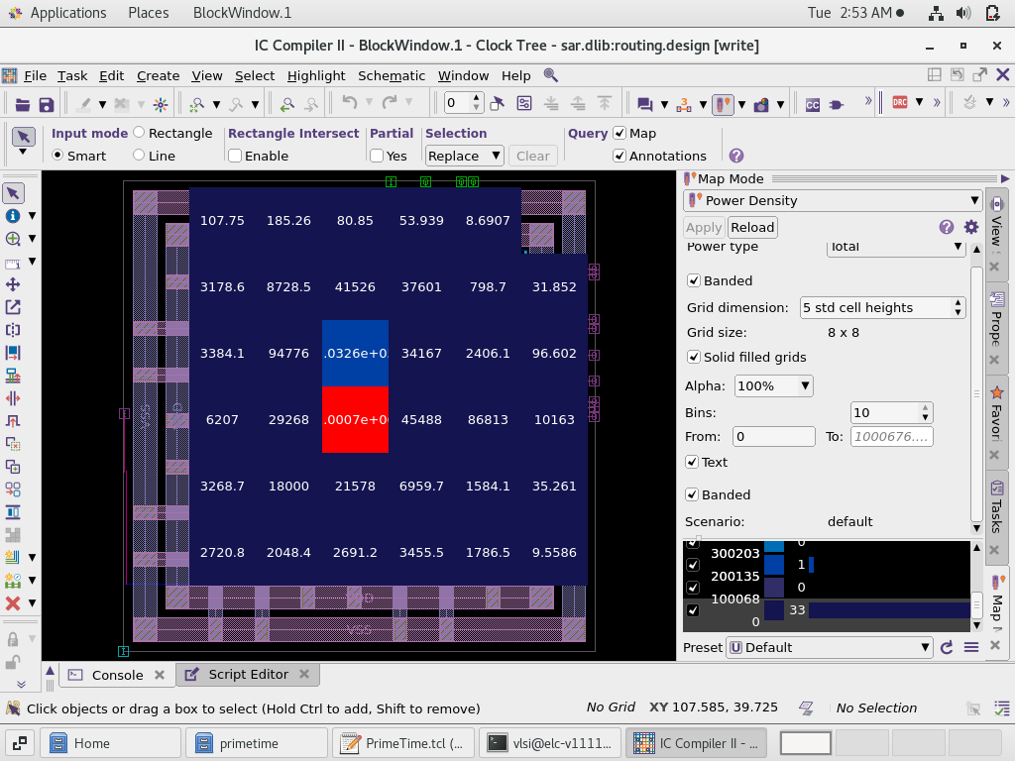
POWER DENSITY

Slide 21
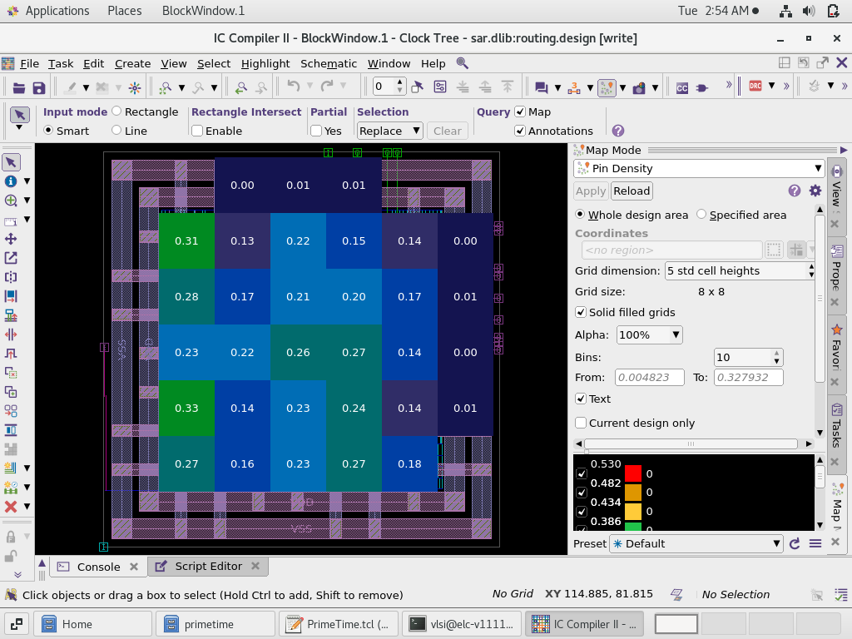
PIN DENSITY

Slide 22
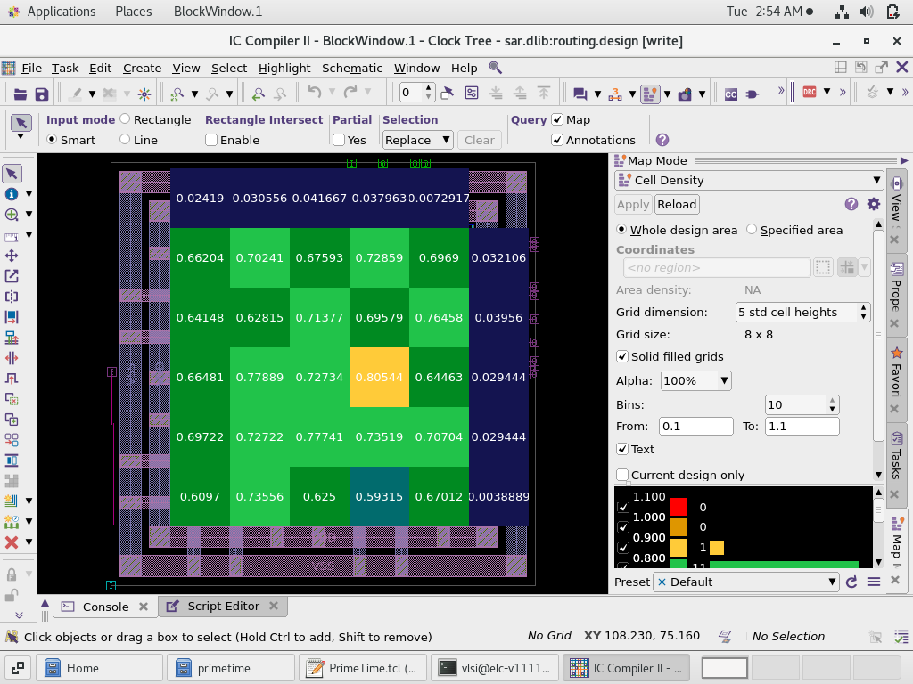
CELL DENSITY

Slide 23
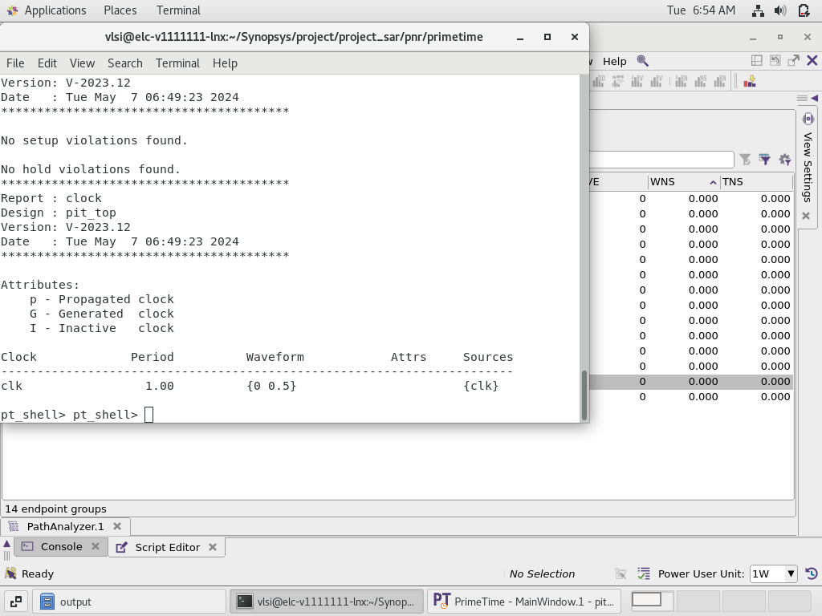
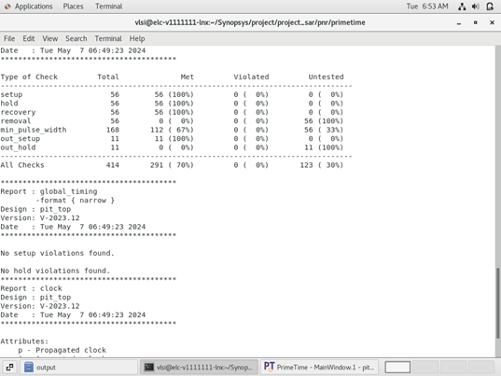
PRIME TIME

Slide 24

THANKS

